Slide 1
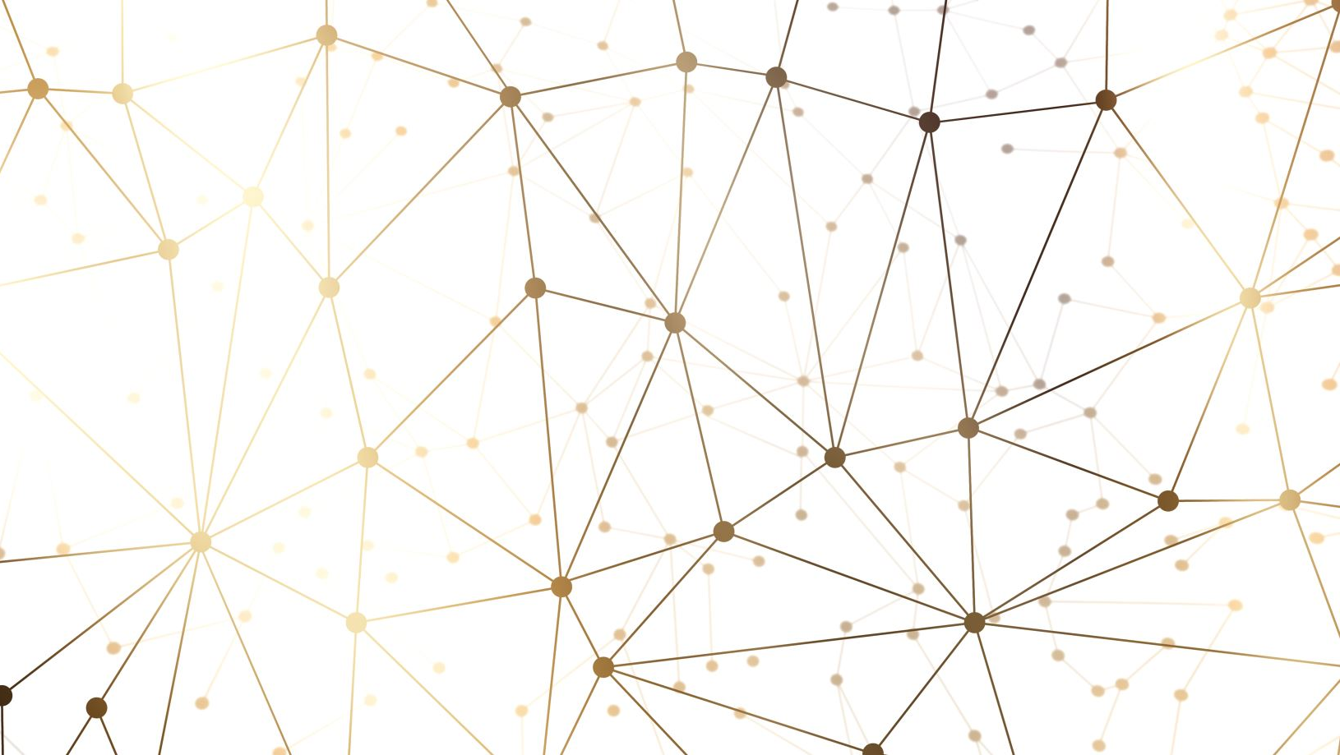
Lung X-Ray Imaging
An Ensemble Learning Approach to CNN Disease Detection
Group 11: Isidro Pride, Austin Rivera, Rishi Sharma

Slide 2
Background & Issues
COVID caused an increase in long term lung defects within US population.
Faster detection of unhealthy lungs from X-Ray imaging would greatly help medical centers identify at-risk patients.
Compare different model architectures and approaches to identify optimal paths to building larger more general disease detection models.
Medical Center data security
Notes:
Rishi
https://www.hopkinsmedicine.org/health/conditions-and-diseases/coronavirus/what-coronavirus-does-to-the-lungs

Slide 3
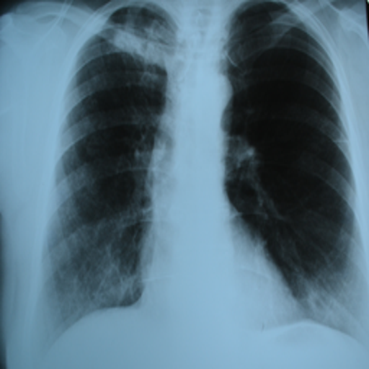
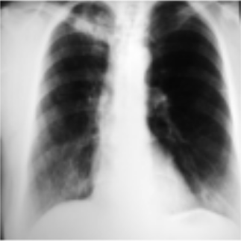
Data PreProcessing
Example: Raw Image
Differing sources of data mean we need some standardization
Resize image, greyscale, and normalize brightness
Should ease the process of adding data from more medical centers
COVID and Pneumonia models seem to benefit more from using processed images
Example: Processed Image
Datasets Overviews
Tuberculosis: 700 w/ TB, 3500 Normal
Pneumonia: 3875 w/ Pneumonia, 1340 Normal
COVID: 1790 w/ COVID, 1300 Normal
Total Training Data: 6365 Unhealthy, 6140 Normal
Notes:
Rishi Pneumonia came with some validation and test data as well, while the others did not.

Slide 4
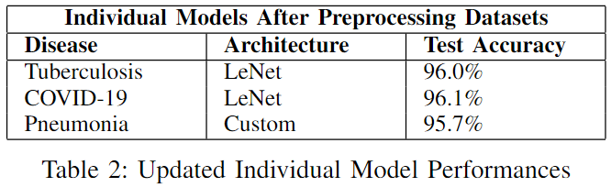
Model Architecture: Individual Models
The Pneumonia, COVID, and Tuberculosis Models are all built on LeNet
Pneumonia is a custom model built upon LeNet but with additional layers
COVID and Tuberculosis are the same
Pneumonia
COVID & Tuberculosis
Notes:
Pneumonia is a custom model predicated on the LeNet architecture.

Slide 5
Model Architecture: aggregate Models
Ensemble Model: The model would consist of two model layers with one that feeds into the next.
Layer One: CNN trained and validated on an even split of healthy and unhealthy lung images.
Layer Two: Three disease-specific CNNs.
Dual Model: A one-class CNN (Healthy vs Non-Healthy), followed by a single three-class CNN (TB vs Pneumonia vs COVID).
Four-Class Model: A single four-class CNN to classify across Healthy, TB, Pneumonia, and COVID.

Slide 6
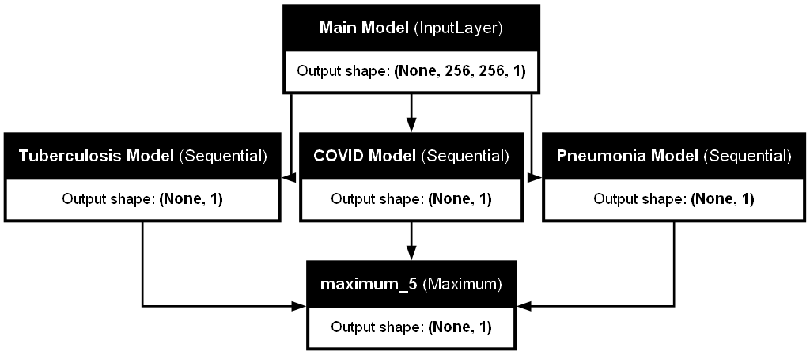
Model Architecture: Ensemble Model
Ensemble Model: The model would consist of two model layers with one that feeds into the next.
LeNet
LeNet
LeNet
Custom

Slide 7
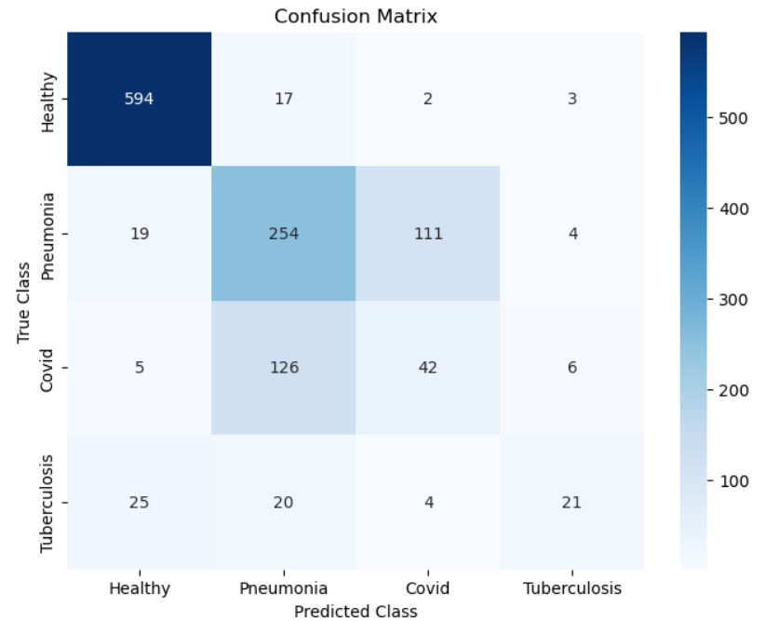
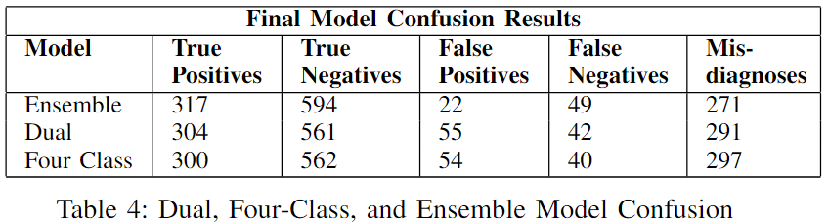
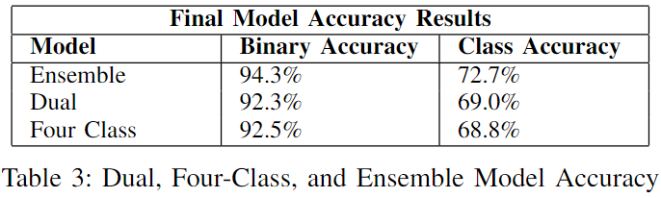
Results
Ensemble model performs the best in terms of overall binary and class prediction accuracy
Misdiagnoses seem prevalent in all model types
False negatives are the biggest worry when deploying
Ensemble Model Confusion Matrix

Slide 8
Conclusion
Data preprocessing played a crucial role in improving model performance
Standardizing image size & color proved best
Ensemble model performed the best comparative to dual and Four-class model
Ensemble model still ran into problems differentiating between certain diseases. COVID and Pneumonia
GitHub: austin-t-rivera/lung_xray_models (github.com)
Notes:
False negatives would be particularly impactful in our case as it could be fatal/legally very bad to send a very sick individual home. On the flip side, we also don't want to treat/make a patient spend more than they have to if they are not actually sick.
Ensemble modeling is a process where multiple diverse models are created to predict an outcome, either by using many different modeling algorithms or using different training data sets. The ensemble model then aggregates the prediction of each base model and results in once final prediction for the unseen data. The motivation for using ensemble models is to reduce the generalization error of the prediction.
A one-class CNN, followed by a threeclass
CNN. Similar to the ensemble, this model consists
of an initial model that evaluates if the test lungs are
healthy or unhealthy, and would be trained in the same
way. This differs in that the subsequent model would
combine the three disease areas and aim to distinguish
between each of them.
color adjustment, gray-scaling, and zoom

Slide 9
Future Steps
Data & Preprocessing:
Increasing dataset size: data augmentation & collecting more data
Data & patient sub-categorization
Insight from medical experts
Model & Architecture
Differing Ensemble techniques: weighted average, average, convergence
Generative Adversarial Networks
Further Categorization
Notes:
False negatives would be particularly impactful in our case as it could be fatal/legally very bad to send a very sick individual home. On the flip side, we also don't want to treat/make a patient spend more than they have to if they are not actually sick.
Ensemble modeling is a process where multiple diverse models are created to predict an outcome, either by using many different modeling algorithms or using different training data sets. The ensemble model then aggregates the prediction of each base model and results in once final prediction for the unseen data. The motivation for using ensemble models is to reduce the generalization error of the prediction.
A one-class CNN, followed by a threeclass
CNN. Similar to the ensemble, this model consists
of an initial model that evaluates if the test lungs are
healthy or unhealthy, and would be trained in the same
way. This differs in that the subsequent model would
combine the three disease areas and aim to distinguish
between each of them.
color adjustment, gray-scaling, and zoom

Slide 10
Appendix
Notes:
False negatives would be particularly impactful in our case as it could be fatal/legally very bad to send a very sick individual home. On the flip side, we also don't want to treat/make a patient spend more than they have to if they are not actually sick.
Ensemble modeling is a process where multiple diverse models are created to predict an outcome, either by using many different modeling algorithms or using different training data sets. The ensemble model then aggregates the prediction of each base model and results in once final prediction for the unseen data. The motivation for using ensemble models is to reduce the generalization error of the prediction.
A one-class CNN, followed by a threeclass
CNN. Similar to the ensemble, this model consists
of an initial model that evaluates if the test lungs are
healthy or unhealthy, and would be trained in the same
way. This differs in that the subsequent model would
combine the three disease areas and aim to distinguish
between each of them.
color adjustment, gray-scaling, and zoom

Slide 11
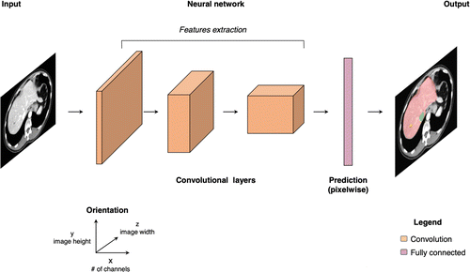
Deep learning in Radiology
https://pubs.rsna.org/doi/10.1148/rg.2021200210
Tasks that are the focus of Deep Learning in Radiology include: Image Classification, Object Detection, Semantic Segmentation, and Instance Segmentation
Convolutional Neural Networks (CNNs) have seen the most advancements in efficiency for Radiology
Ensemble Networks can be useful to detect the presence of multiple different defects within a patient
Generative Adversarial Networks (GANs) are also commonly used to develop more synthetic images from MRIs and X-Rays (likely won’t be explored)
Notes:
Rishi
CNN modeling advancements:
Skip Connections: Shortcuts, or residual connections, that allow a model to skip unnecessary layers of a deep network to improve efficiency.
• Bottleneck Blocks: A sequence of layers that cause the model to reduce dimensionality, extract features, then restore dimensionality by reducing the number of features, increasing the kernel size, then restoring the kernel size and increasing the number of features, respectively.
• Multi-Branch Convolutions: Utilizing parallel convolutional layers of varying kernel sizes, then combining them via concatenation or summation, to produce a potentially more efficient and robust model.
• Wider Networks: Networks with more feature maps and/or channels per convolutional layer. This is still actively being explored more as a next step to build upon these very deep networks without making them deeper. The trade off for gaining efficiency is often increased memory usage, which can be constraining.
• Ensemble Networks: Multiple networks within a larger network. Smaller fine-tuned networks within a larger one has the potential of being easier to train and lead to better performance.

Slide 12
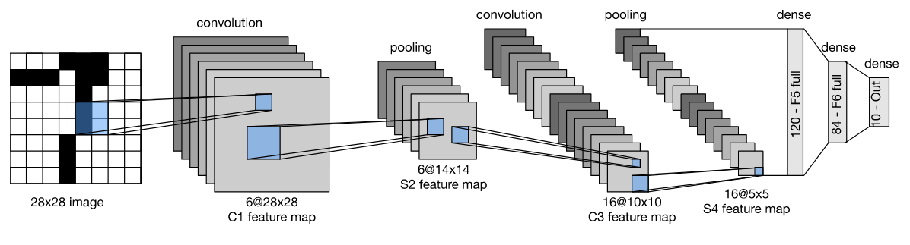
Lenet architecture
https://lekhuyen.medium.com/lenet-and-mnist-handwritten-digit-classification-354f5646c590
256x256 image
6@128x128
S2 feature map
Notes:
Rishi
CNN modeling advancements:
Skip Connections: Shortcuts, or residual connections, that allow a model to skip unnecessary layers of a deep network to improve efficiency.
• Bottleneck Blocks: A sequence of layers that cause the model to reduce dimensionality, extract features, then restore dimensionality by reducing the number of features, increasing the kernel size, then restoring the kernel size and increasing the number of features, respectively.
• Multi-Branch Convolutions: Utilizing parallel convolutional layers of varying kernel sizes, then combining them via concatenation or summation, to produce a potentially more efficient and robust model.
• Wider Networks: Networks with more feature maps and/or channels per convolutional layer. This is still actively being explored more as a next step to build upon these very deep networks without making them deeper. The trade off for gaining efficiency is often increased memory usage, which can be constraining.
• Ensemble Networks: Multiple networks within a larger network. Smaller fine-tuned networks within a larger one has the potential of being easier to train and lead to better performance.

